Slide 1


A Presentation On
The Smart City Sentinel – A Modular PCB for Intelligent Environmental Monitoring
Team Name – Achievers
Objective of Project :-The objective is to design a modular PCB for urban environmental monitoring, ensuring sensor integration, power management, real-time data transmission, and scalability, with optimized power consumption and solar panel support.

Slide 2





Planned Project Milestones
1
2
3
4
5
Understanding of given problem statement
Understanding of Requirements
System design and Architecture
PCB design in KiCad
Final review and
result
Key Document
Identify the need for a modular PCB for environmental monitoring in urban areas.
Ensure integration of sensor interfacing, power management, and real-time data transmission.
Understand the given hardware components (ESP32-S3, sensors, power modules, etc.).
Develop the solution by utilizing provided components
Develop a block diagram showing sensor integration with ESP32-S3 and power management.
Plan communication protocols for efficient data transfer.
Create the schematic diagram with proper sensor and module connections.
Design a multi-layer PCB layout with optimized routing, power distribution, and minimal noise interference.
Simulate the PCB design in KiCad to verify connectivity and functionality.
Perform debugging and optimizations to ensure stability before final submission.

Slide 3
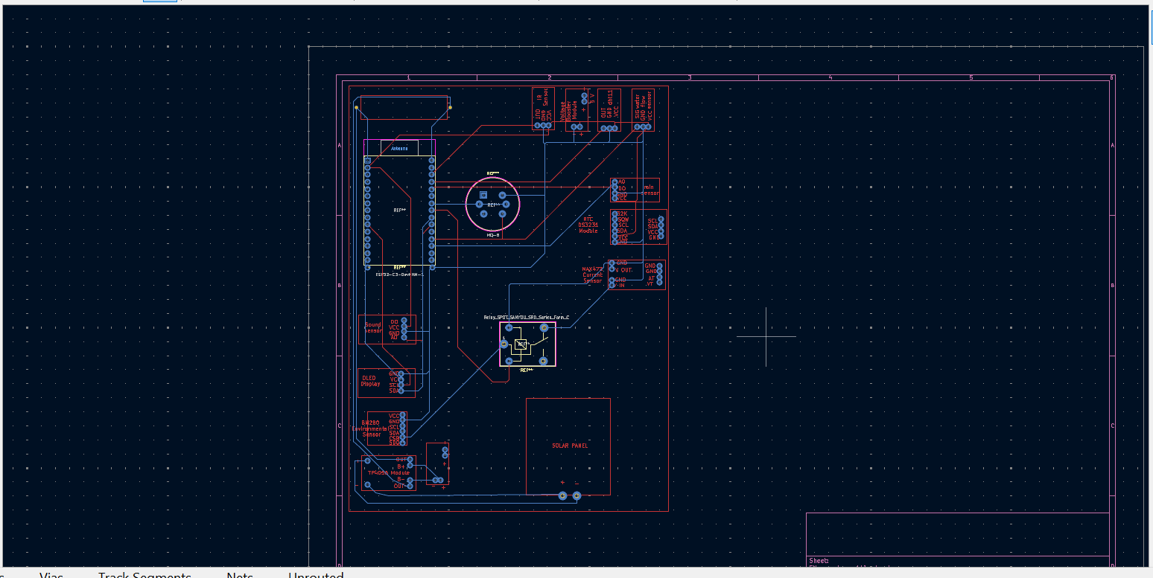
Milestone output :-
1
Github link - https://github.com/Bhongalesarthak/UNPULGGED

Slide 4

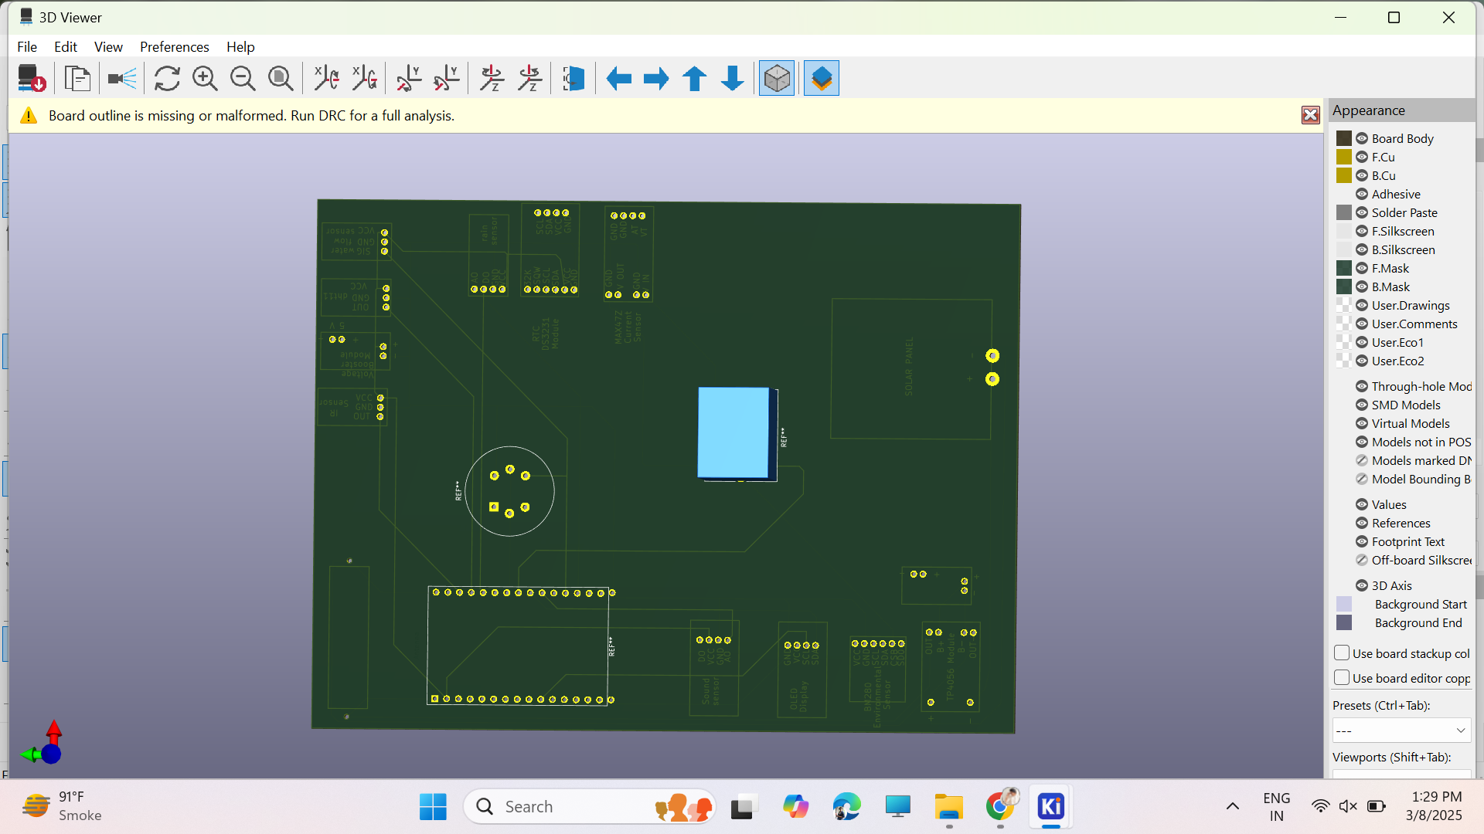
2
Simulation of circuit in software

Slide 5

2020
BOM(Bills of materials) analyzation
Here’s an estimated cost table for your components based on general market prices:
Sr. No | Components | Quantity | Estimated Cost per Unit (INR) | Total Cost (INR)
1 | ESP32-S3 Dev module | 1 | 569/- | 569/-
2 | MQ-135 Gas Sensor | 1 | 120/- | 120/-
3 | Sound Sensor Module | 1 | 150/- | 150/-
4 | OLED Display | 1 | 400/- | 400/-
5 | Dust Sensor | 1 | 599/- | 599/-
6 | BME280 Environmental Sensor | 1 | 1349/- | 1349/-
7 | Solar Panel | 1 | 350/- | 350/-
8 | Rechargeable Module (TP4056) | 1 | 30/- | 30/-
9 | IR Flame Sensor | 1 | 258/- | 258/-
10 | Battery 3.7v 2500mAh 18560 | 1 | 479/- | 479/-
11 | Voltage Booster | 1 | 179/- | 179/-

Slide 6
2020
BOM(Bills of materials) analyzation
Here’s an estimated cost table for your components based on general market prices:
Sr. No | Components | Quantity | Estimated Cost per Unit (INR) | Total Cost (INR)
12 | Hall Effect Sensor | 1 | 550/- | 550/-
13 | MAX471 Current and Voltage Sensor | 1 | 251/- | 251/-
14 | Water Flow Sensor | 1 | 199/- | 199/-
15 | DHT11 Temperature and Humidity Sensor | 1 | 169/- | 169/-
16 | Soil Moisture Sensor | 1 | 50/- | 50/-
17 | Relay Module | 1 | 130/- | 130/-
18 | Rain Sensor | 1 | 53/- | 53/-
19 | RTCDS3231 Module | 1 | 370/- | 370/-

Slide 7


Thank You!
For your attention

